Slide 1
KNOWLEDGE, LEARNING & INFERENCE
Paula Parpart
Dept. of Experimental Psychology

Slide 2
Computational Models of Cognition: I. Bayesian Models of Cognition II. The Future of AI: Human vs Machine Learning
Paula Parpart
Experimental Psychology

Slide 3
COURSE OVERVIEW
16/01/2016 – Paula Parpart: Computational Models of Cognition
23/01/2016 – Maarten Speekenbrink: Instance vs. Abstraction Learning
30/01/2016 – Kurt Braunlich: Category Learning and the Brain
06/02/2016 – Eric Schulz: Reinforcement & Function Learning
tbc - Dave Lagnado: Bayesian Networks in Evidential Reasoning
--- READING WEEK –
20/02/2016 – Christos Bechlivanidis: Causal Models: Representation, Learning and Inference
27/02/2016 – Paula Parpart: Active Learning
06/03/2016 – Paula Parpart: Heuristics as Bayesian Inference
13/03/2016 – Adam Harris: Bayesian Argumentation
20/03/2016 – Brad Love: A cognitive science informed Turing Test
Personal research

Slide 4
COURSE OVERVIEW
Learning
16/01/2016 – Paula Parpart: Computational Models of Cognition
23/01/2016 – Maarten Speekenbrink: Instance vs. Abstraction Learning
30/01/2016 – Kurt Braunlich: Category Learning and the Brain
06/02/2016 – Eric Schulz: Reinforcement & Function Learning
tbc - Dave Lagnado: Bayesian Networks in Evidential Reasoning
--- READING WEEK –
20/02/2016 – Christos Bechlivanidis: Causal Models: Representation, Learning and Inference
27/02/2016 – Paula Parpart: Active Learning
06/03/2016 – Paula Parpart: Heuristics as Bayesian Inference
13/03/2016 – Adam Harris: Bayesian Argumentation
20/03/2016 – Brad Love: A cognitive science informed Turing Test (Learning)

Slide 5
COURSE OVERVIEW
Representation (= Knowledge)
16/01/2016 – Paula Parpart: Computational Models of Cognition
23/01/2016 – Maarten Speekenbrink: Instance vs. Abstraction Learning
30/01/2016 – Kurt Braunlich: Category Learning and the Brain
06/02/2016 – Eric Schulz: Reinforcement & Function Learning
tbc - Dave Lagnado: Bayesian Networks in Evidential Reasoning
(Representation & Inference)
--- READING WEEK –
20/02/2016 – Christos Bechlivanidis: Causal Models: Representation, Learning and Inference
27/02/2016 – Paula Parpart: Active Learning (Representation & Learning)
06/03/2016 – Paula Parpart: Heuristics as Bayesian Inference
13/03/2016 – Adam Harris: Bayesian Argumentation
20/03/2016 – Brad Love: A cognitive science informed Turing Test (Representation)

Slide 6
COURSE OVERVIEW
Inference
16/01/2016 – Paula Parpart: Computational Models of Cognition
23/01/2016 – Maarten Speekenbrink: Instance vs. Abstraction Learning
30/01/2016 – Kurt Braunlich: Category Learning and the Brain
06/02/2016 – Eric Schulz: Reinforcement & Function Learning
tbc - Dave Lagnado: Bayesian Networks in Evidential Reasoning
(Representation & Inference)
--- READING WEEK –
20/02/2016 – Christos Bechlivanidis: Causal Models: Representation, Learning and Inference
27/02/2016 – Paula Parpart: Active Learning
06/03/2016 – Paula Parpart: Heuristics as Bayesian Inference
13/03/2016 – Adam Harris: Bayesian Argumentation (Inference)
20/03/2016 – Brad Love: A cognitive science informed Turing Test (Inference)

Slide 7
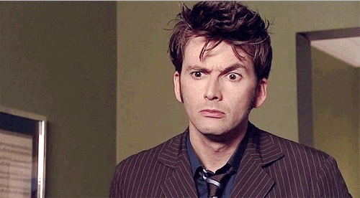
COURSE OVERVIEW
Bayesian?
16/01/2016 – Paula Parpart: (Bayesian) Computational Models of Cognition
23/01/2016 – Maarten Speekenbrink: Instance vs. Abstraction Learning
30/01/2016 – Kurt Braunlich: Category Learning and the Brain
06/02/2016 – Eric Schulz: Reinforcement & Function Learning
tbc - Dave Lagnado: Bayesian Networks in Evidential Reasoning
--- READING WEEK –
20/02/2016 – Christos Bechlivanidis: Causal Models: Representation, Learning and Inference
27/02/2016 – Paula Parpart: Active Learning
06/03/2016 – Paula Parpart: Heuristics as Bayesian Inference
13/03/2016 – Adam Harris: Bayesian Argumentation (Inference)
20/03/2016 – Brad Love: A cognitive science informed Turing Test (Inference)

Slide 8

Logistics
Readings for all lectures are uploaded on Moodle.
Read at least one before the lecture
Lecture slides will be on Moodle before or slightly after each lecture.
Lectures are usually recorded – recordings will appear on moodle
Assessment: 100% coursework
Essay topics will be announced on Moodle
Deadline: 27/04/2017
For any lecture related question email the lecturer
For any general issue about the module email Paula (paula.parpart@ucl.ac.uk)

Slide 9
MORE DISCUSSION!

Slide 10
TOPIC OVERVIEW
Bayesian Models of Cognition

Slide 11
If you were assessing the prospects of a 60-year-old man, how much longer would you expect him to live?

Slide 12
Life poses many of these inductive problems where the true answer cannot be determined on the basis of the limited data available
Yet common sense suggests at least reasonable guess
→ Accounts of perception and memory suggest that these systems effectively approximate optimal statistical inference, correctly combining new data with an accurate probabilistic model of the environment (Anderson, 1990; Anderson & Schooler, 1991)

Slide 13
Contrasting hypotheses
traditionally | Griffiths & Tenenbaum (2006)
Cognitive everyday judgements are error prone due to the use of heuristics (Kahneman & Tversky’s work) Heuristics are insensitive to prior probabilities | People are near-optimal and are able to make smart predictions from sparse data even with everyday cognitive judgements Near-optimal -> optimal statistical inference = optimal Bayesian inference
Notes:
These 2 visions of cognition are starkly at odds.

Slide 14
How do cognitive judgements compare with optimal statistical inference?
People | Optimal Bayesian model
Ask people to predict the duration or extent of everyday phenomena | Generate predictions of an optimal Bayesian model with assumed prior distributions
Compare!
Notes:
These 2 visions of cognition are starkly at odds.

Slide 15
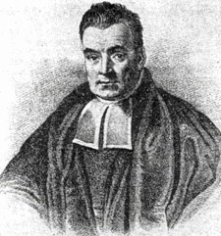
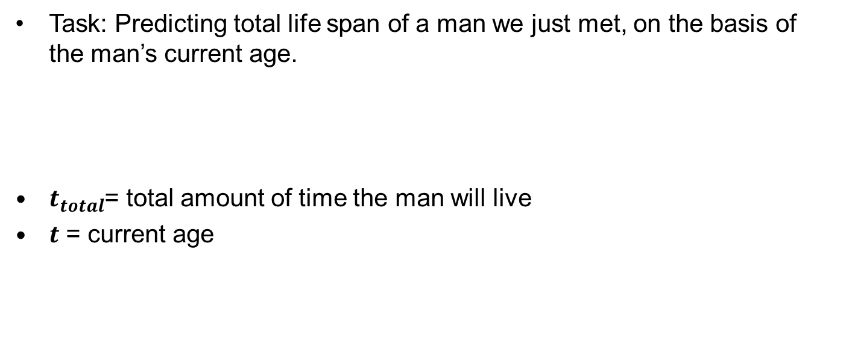
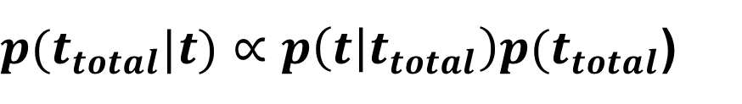
Bayes Theorem
Task: Predicting total life span of a man we just met, on the basis of the man’s current age.
$t_{total}$= total amount of time the man will live
$t$ = current age
$p(t_{total}|t)∝p\left(t | t_{total}\right)p(t_{total}$)
Notes:
These 2 visions of cognition are starkly at odds.

Slide 16
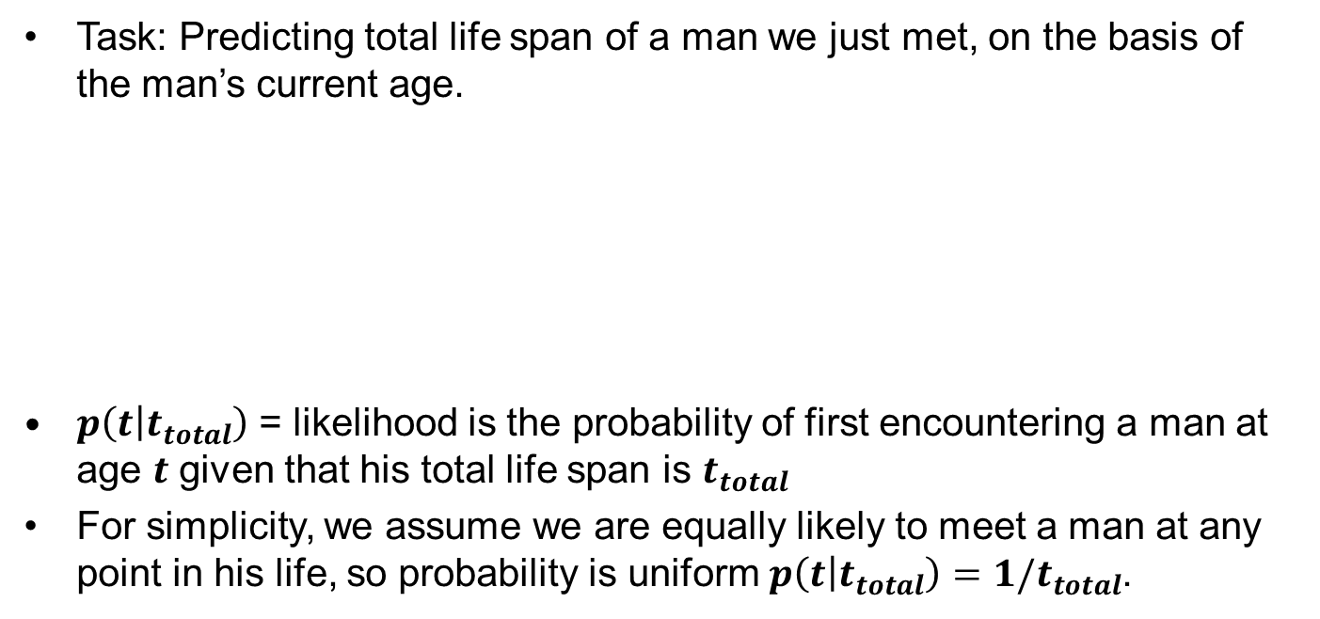
Bayes Theorem
Task: Predicting total life span of a man we just met, on the basis of the man’s current age.
$p\left(t | t_{total}\right)$ = likelihood is the probability of first encountering a man at age $t$ given that his total life span is $t_{total}$
For simplicity, we assume we are equally likely to meet a man at any point in his life, so probability is uniform $p\left(t | t_{total}\right)=1/t_{total}$.
$p(t_{total}|t)∝p\left(t | t_{total}\right)p(t_{total}$)
likelihood
Notes:
These 2 visions of cognition are starkly at odds.

Slide 17
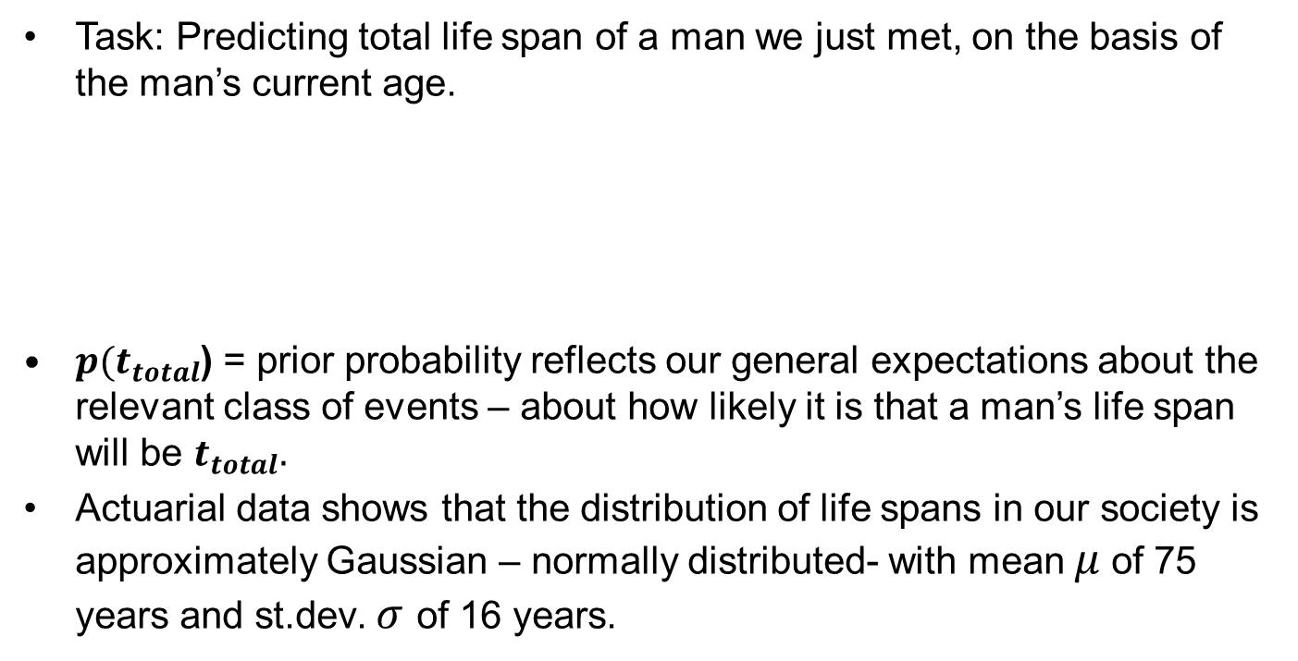
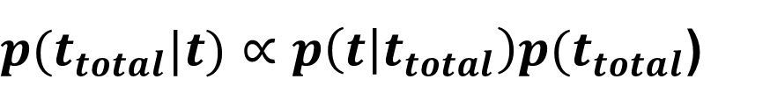
Bayes Theorem
Task: Predicting total life span of a man we just met, on the basis of the man’s current age.
$p(t_{total}$) = prior probability reflects our general expectations about the relevant class of events – about how likely it is that a man’s life span will be $t_{total}.$
Actuarial data shows that the distribution of life spans in our society is approximately Gaussian – normally distributed- with mean $μ$of 75 years and st.dev. $σ$ of 16 years.
$p(t_{total}|t)∝p\left(t | t_{total}\right)p(t_{total}$)
prior
Notes:
These 2 visions of cognition are starkly at odds.

Slide 18
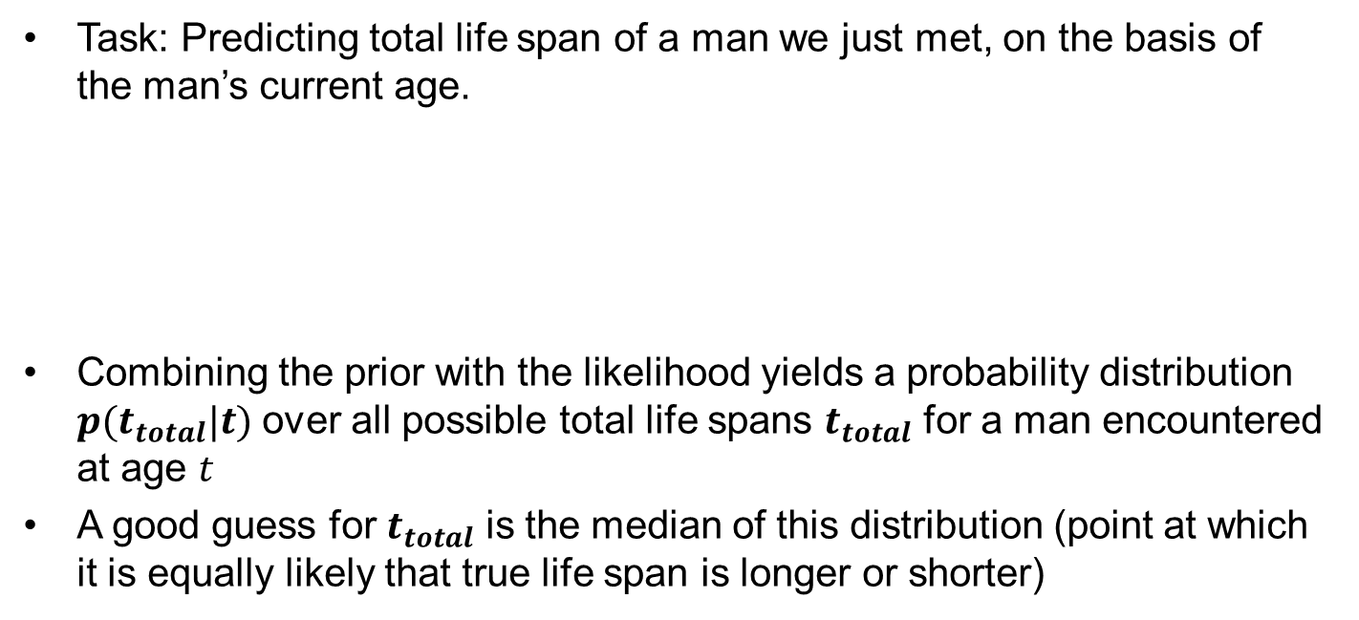
Bayes Theorem
Task: Predicting total life span of a man we just met, on the basis of the man’s current age.
Combining the prior with the likelihood yields a probability distribution $p(t_{total}|t)$ over all possible total life spans $t_{total}$ for a man encountered at age $t$
A good guess for $t_{total}$ is the median of this distribution (point at which it is equally likely that true life span is longer or shorter)
prior beliefs
my updated beliefs
$p(t_{total}|t)∝p\left(t | t_{total}\right)p(t_{total}$)
posterior
likelihood
prior
Bayesian prediction function
Notes:
This approach is quite general. Applicable to any problem that requires estimating the upper limit of a duration, extent or other numerical quantitiy given a sample drawn from that interval.

Slide 19
Different priors for different phenomena
Empirical prior distributions
Notes:
The bottom row shows participants’ predicted values of ttotal for a single observed sample t of a duration or extent for each phenomenon.
Black dots show the participants’ median predictions of ttotal.
Solid lines show the optimal Bayesian predictions based on the empirical prior distributions shown above
Dotted lines show predictions based on a fixed uninformative prior

Slide 20
If you were the executive evaluating the performance of a movie that had made $40 million at the box office so far, what would you estimate for its total sales?

Slide 21
Results
People’s judgements for life spans, movie run times, etc. were indistinguishable from optimal Bayesian predictions based on the empirical prior distributions.
→ This was an example of Bayesian updating in cognitive science.
traditionally | Griffiths & Tenenbaum (2006)
Cognitive everyday judgements are error prone due to the use of heuristics (Kahneman & Tversky’s work) | People are near-optimal and are able to make smart predictions from sparse data even with everyday cognitive judgements
Notes:
The bottom row shows participants’ predicted values of ttotal for a single observed sample t of a duration or extent for each phenomenon.
Black dots show the participants’ median predictions of ttotal.
Solid lines show the optimal Bayesian predictions based on the empirical prior distributions shown above
Dotted lines show predictions based on a fixed uninformative prior

Slide 22

Bayesian Models of Cognition
Vision research has shown that sensory processing can be as accurately modeled as a process of Bayesian updating (e.g., Yuille & Kersten, 2006; Kersten, Mamassian & Yuille, 2004; or Jacobs, 2002, on Bayesian depth perception). Even motor control appears to approach Bayesian optimality (Körding & Wolpert, 2004).
some researchers claim that Bayesian statistics provide a general framework for understanding human inductive inference:
Learning (Tenenbaum, 1999), human reasoning under uncertainty (Oaksfoard & Chater, 1994), categorisation (Tenenbaum & Griffiths, 2001), counterfactual inference and causal representation (Pearl, 2000; Griffiths & Tenenbaum, 2006; Sloman & Lagnado, 2005), and for modeling language acquisition (e.g., Hsu & Chater, 2010).

Slide 23

Bayesian Models of Cognition
Bayesian Fundamentalism | Bayesian Enlightenment
The Bayesian model itself exists at a computational level, where its predictions are defined only based on optimal inference (Bayes laws) and decision-making. The mechanisms by which those decision are determined are outside the model’s scope.

Slide 24
Bayesian Models of Cognition
Bayesian Fundamentalism | Bayesian Enlightenment
Cognitive behaviour can be explained from rational principles alone & without reference to psychological or neurological processes Significantly under constrained Like Behaviourism (black box)? | Developed in conjunction with mechanistic considerations Performing model comparisons of different Bayesian models Take into account representations

Slide 25

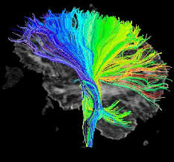
MARR’S (1982) LEVELS
Computational
What problem is the brain solving? What information is required? What is the structure of the environment?
Algorithmic
What processes does the mind execute to produce the solution?
What algorithms are computed?
Implementational
Hardware: How are those algorithms implemented in the brain?
Notes:
Cognitive scientists disagree over whether explanations at all levels are useful, and on the order in which levels should be explored.

Slide 26
TOPIC OVERVIEW
The Future of AI: Human vs. Machine Learning
Notes:
Artificial and machine learning has been inspired by the brain in the past (every top technique)
We use new AI/machine learning models to build more sophisticated cognitive models (we can optimtize complex models – we can build sophisticated accounts of the brain and test them)

Slide 27
- INTERMEZZO: DISCUSSION
What do you think an AI has to possess in order to be truly “intelligent”?
- i.e., Learning and thinking like a person
Notes:
To be truly thinking and learning like a person?

Slide 28
Recent developments in AI
Engineering trends: Deep Neural Networks
What can they do?
Object recognition
Speech recognition
Learn how to play video games
…
Notes:
Made huge progress recently due to deep neural networks

Slide 29
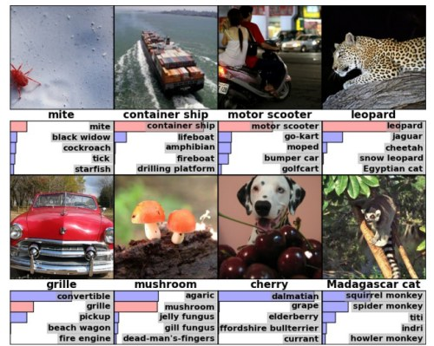
Deep Neural Networks: object recognition
Krizhevsky et al. (2012): deep convolutional network that nearly halved the error rate of previous state-of-the-art algorithms
Most challenging benchmark: ImageNet is a dataset of over 15 million labeled high-resolution images belonging to roughly 22,000 categories
Notes:
The images were collected from the web and labeled by human labelers using Amazon’s Mechanical Turk crowd-sourcing tool.

Slide 30
How do Neural Networks (NNs) work? A very brief Intro.
Example: Object recognition

Slide 31
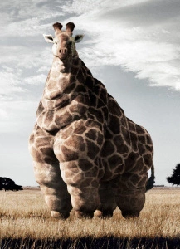
Example: Object recognition
Try to identify:
Notes:
Humans recognize a multitude of objects in images with little effort, despite the fact that the image of the objects may vary somewhat in different view points, in many different sizes and scales or even when they are translated or rotated.

Slide 32
Object recognition
We do this with the 80 billion neurons in our brain working together to transmit information.
This remarkable system of neurons is also the inspiration behind a widely-used machine learning technique called Artificial Neural Networks (NN).
Notes:
Humans recognize a multitude of objects in images with little effort, despite the fact that the image of the objects may vary somewhat in different view points, in many different sizes and scales or even when they are translated or rotated.

Slide 33
Object recognition
Some computers using NN’s have even out-performed humans in recognizing images.

Slide 34
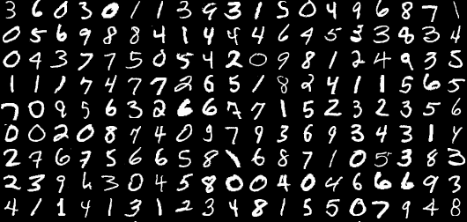
The Problem: Recognize handwritten digits
Image recognition is used in technology for visual surveillance, guiding autonomous vehicles, identifying abnormalities in X-ray images, smartphone app that converts handwriting into typed words, etc.
How can we train an artificial neural network to recognize images of handwritten digits?

Slide 35
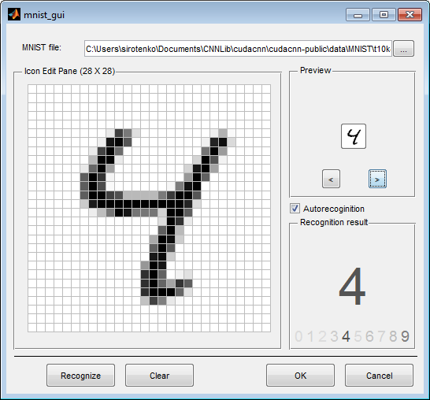

The Problem: Classify digits 0-9
Input layer:
784 variables,
one per pixel
28 x 28 pixels
784 pixels coded as numbers based on darkness
Notes:
We are going to take an image as an input.
You are going to break it down into pixels.
Change those pixels into numbers based on how dark the light is.

Slide 36
The Problem: Classify digits 0-9
Training: NN model is trained by giving it examples of 10,000 handwritten digits, together with the correct digits they represent. → allows the NN model to understand how the handwriting translates into actual digits.
Handwritten digits in the MNIST database
Testing/Validation: After the NN model is trained, we can test how well the model performs by giving it 1,000 new handwritten digits without the correct answer. The model is then required to recognize the actual digit.
This process is called cross-validation.

Slide 37
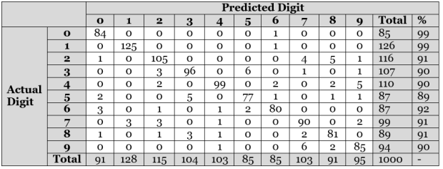
The Problem: Recognize handwritten digits
Contingency table to view results:
Out of the 1,000 handwritten images that the model was asked to recognize, it correctly identified 922 of them, which is a 92.2% accuracy.

Slide 38
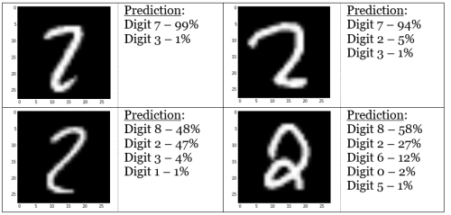
The Problem: Recognize handwritten digits
Some of the digits get confused.

Slide 39
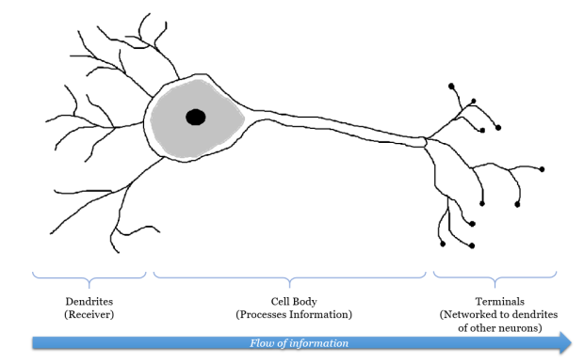
The neurons that inspired the network
If level of signals is high enough, neuron sends electrical pulse to terminals
Outgoing signals are then received by other neurons.
Incoming signals by other neurons
Notes:
When different information is sent from A to B, the brain activates different sets of neurons, and so essentially uses a different route to get from A to B.
Human Neuron: At each neuron, dendrites receive incoming signals sent by other neurons. If the neuron receives a high enough level of signals within a certain period of time, the neuron sends an electrical pulse into the terminals.

Slide 40
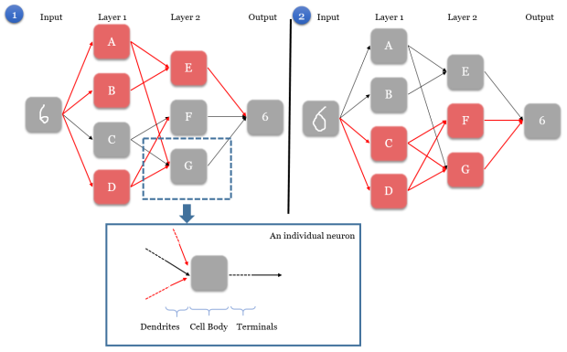
HOW THE MODEL WORKS
Input node
Output node
Notes:
Explain structure and layers.

Slide 41
HOW THE MODEL WORKS
Input node
Output node
Step 1: When input node is given an image, it activates a unique set of neurons in first layer
Notes:
starting a chain reaction that would pave a unique path to the output node. In Scenario 1, neurons A, B, and D are activated in layer 1.

Slide 42
HOW THE MODEL WORKS
Input node
Output node
Step 2: activated neurons send signals to every connected neuron in the next layer
Notes:
Step 2. The activated neurons send signals to every connected neuron in the next layer. This directly affects which neurons are activated in the next layer. In Scenario 1, neuron A sends a signal to E and G, neuron B sends a signal to E, and neuron D sends a signal to F and G.

Slide 43
HOW THE MODEL WORKS
Input node
Output node
Step 3: In next layer, each neuron is governed by a rule on what combinations of received signals would activate the neuron
Notes:
Step 3. In the next layer, each neuron is governed by a rule on what combinations of received signals would activate the neuron.
In Scenario 1, neuron E is activated by the signals from A and B. However, for neuron F and G, their neurons’ rules tell them that they have not received the right signals to be activated, and hence they remain grey.

Slide 44
HOW THE MODEL WORKS
Input node
Output node
Step 4: Steps 2-3 are repeated for all the remaining layers (it is possible for the model to have more than 2 layers), until we are left with the output node.
Notes:
Step 4. Steps 2-3 are repeated for all the remaining layers (it is possible for the model to have more than 2 layers), until we are left with the output node.

Slide 45
HOW THE MODEL WORKS
Input node
Output node
Step 5: output node deduces the correct digit based on signals received from neurons in the layer directly preceding it (layer 2).
Notes:
Each combination of activated neurons in layer 2 leads to one solution, though each solution can be represented by different combinations of activated neurons. In Scenarios 1 & 2, two images are fed as input. Because the images are different, the network activates different neural paths from input to the output. However, the output is still recognizes both images as the digit “6”.

Slide 46
HOW THE MODEL WORKS
Input node
Output node
Each solution in Scenario 1 and 2 can be represented by different combinations of activated neurons. Because the images fed as input in Scenarios 1 & 2 are different, the network activates different neural paths from input to the output. However, the output still recognizes both images as the digit “6”.
Notes:
Step 5. The output node deduces the correct digit based on signals received from neurons in the layer directly preceding it (layer 2). Each combination of activated neurons in layer 2 leads to one solution, though each solution can be represented by different combinations of activated neurons. In Scenarios 1 & 2, two images are fed as input. Because the images are different, the network activates different neural paths from input to the output. However, the output is still recognizes both images as the digit “6”.

Slide 47
Training the model
Decide on number of layers and number of neurons in each layer
For the digit recognizer NN, 3 layers with 500 neurons each were used.
Key factors involved in training a model are:
metric to evaluate the model’s accuracy, i.e., loss function (SSE)
Rules that govern whether neurons are activated or not
Notes:
Put simply, a squared error denotes how close a predicted digit is to the actual digit
The NN model will try to minimize the SSE by changing the rules that govern neuron activation (weights)

Slide 48
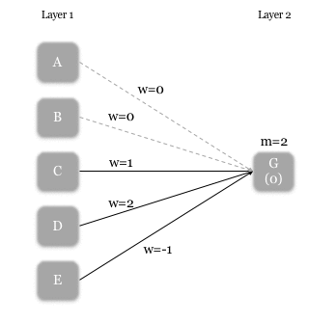
Training the model
Neuron’s activation rule has 2 components:
the weight (i.e. strength) of incoming signals [w]
minimum received signal strength required for activation [m].
Rules for neuron G
Notes:
Zero weight is given to the signals from A and B (i.e. no connection), and weights of 1, 2, and -1 are given to the signals from C, D, and E respectively. The m-value for G is 2, so G is activated if:
D is activated and E is not activated, or if,
C and D are activated.

Slide 49

Neural Networks: Limitations
Computationally expensive.
Training a NN takes more time and CPU power compared to training other types of models (e.g., random forests)
Although NN are not a new technique (1980s and 1990s), they have had arevival in recent years because of hardware advances
2. Lack of feature recognition.
The NN is unable to recognize images if they take on slight variations in shape, or are placed in a different location.
Notes:
For example, if we want our ANN model to recognize images of cats, and suppose our training examples always feature cats at the bottom of the image, then the ANN model would not recognize the same cats if they appear at the top, or the same cats of larger sizes.

Slide 50
Advanced NN: Convolutional Neural Networks
Neural Networks
Convolutional Neural Network
Solves the problem of lack of feature recognition, by looking at various regions of the image.
Notes:
For example, if we want our ANN model to recognize images of cats, and suppose our training examples always feature cats at the bottom of the image, then the ANN model would not recognize the same cats if they appear at the top, or the same cats of larger sizes.

Slide 51
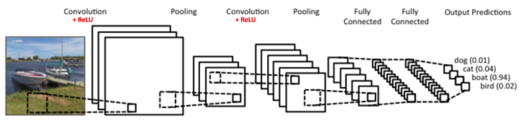
Convolutional Neural Networks (CNNs)
CNNs are more efficient and widely used = A neural network that uses a trainable filter instead of fully-connected layers with independent weights.
Notes:
There are four main steps in CNN: convolution, subsampling, activation and full connectedness.
The first layers that receive an input signal are called convolution filters. Convolution is a process where the network tries to label the input signal by referring to what it has learned in the past. If the input signal looks like previous cat images it has seen before, the “cat” reference signal will be mixed into, or convolved with, the input signal. The resulting output signal is then passed on to the next layer.

Slide 52

Convolutional Neural Networks (CNNs)
CNNs are more efficient and widely used = A neural network that uses a trainable filter instead of fully-connected layers with independent weights.
Notes:
CNNs are too complex to implement from scratch. Today, machine learning practitioners often utilize toolboxes developed such as Caffe, Torch, MatConvNet and Tensorflow for their work.

Slide 53

Advanced NNs: Deep Neural Networks
Deep Neural Networks = A neural network with at least one hidden layer (some networks have dozens).

Slide 54

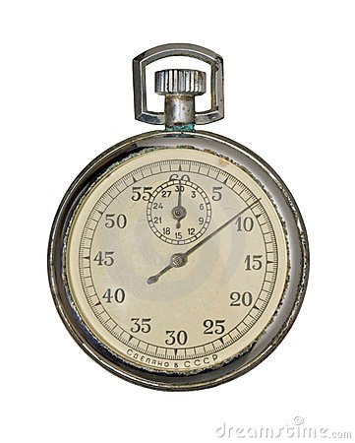
Optimization Method ~ Backpropagation
Loss function
(log-likelihood,
classification error)
Run until error stops improving = converge
Notes:
Uses Stochastic Gradient Descent (differentiation)
Feeds error back into the layers to optimize the weights. It learns from its own errors so to say.
It wiggles the weights and makes small adjustments in the direction that improves the objective function (loss function)

Slide 55

Demo
Hidden
Output
Input
*Yann LeCun

Slide 56
Putting it all back together: Deep Convolutional Networks
Krizhevsky et al. (2012): a deep convolutional neural network is capable of achieving record breaking results in object recognition using purely supervised learning.
“It is notable that our network’s performance degrades if a single convolutional layer is removed. “

Slide 57
Deep Convnets continue to dominate
Best results achieved are very close to human-level performance at an error rate of 0.2% (Ciresan, Meier & Schmidhuber, 2012).
He, Shang, Ren & Sun (2015): recently approaching human-level performance on some benchmarks
Notes:
Our results show that a large, deep convolutional neural network is capable of achieving recordbreaking results on a highly challenging dataset using purely supervised learning. It is notable that our network’s performance degrades if a single convolutional layer is removed. For example, removing any of the middle layers results in a loss of about 2% for the

Slide 58

Agriculture with deep learning drone algorithms
Dramatic improvements in:
Crop and tree counting
Early disease detection
Livestock tracking
Intelligent pesticide delivery
Yield forecasting
Crop design

Slide 59
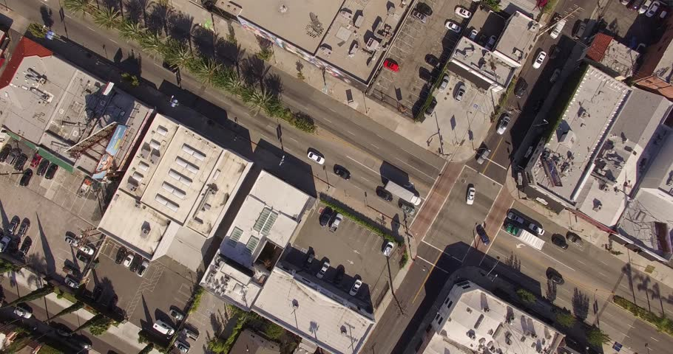
Urban insights with Deep Learning Drone Tech
Fully automated
Parking spot locator
Car counting
Optimizing traffic
Crowd analysis

Slide 60
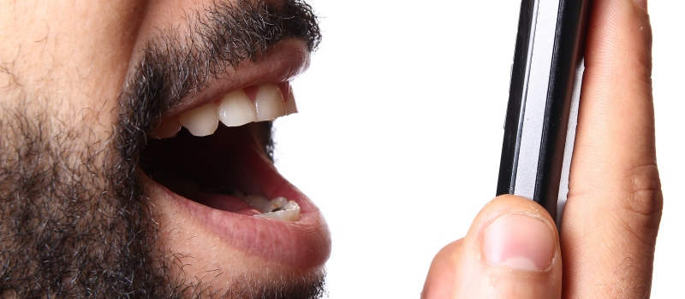
Automatic speech recognition
Hidden Markov Models have been replaced piece by piece with deep learning

Slide 61
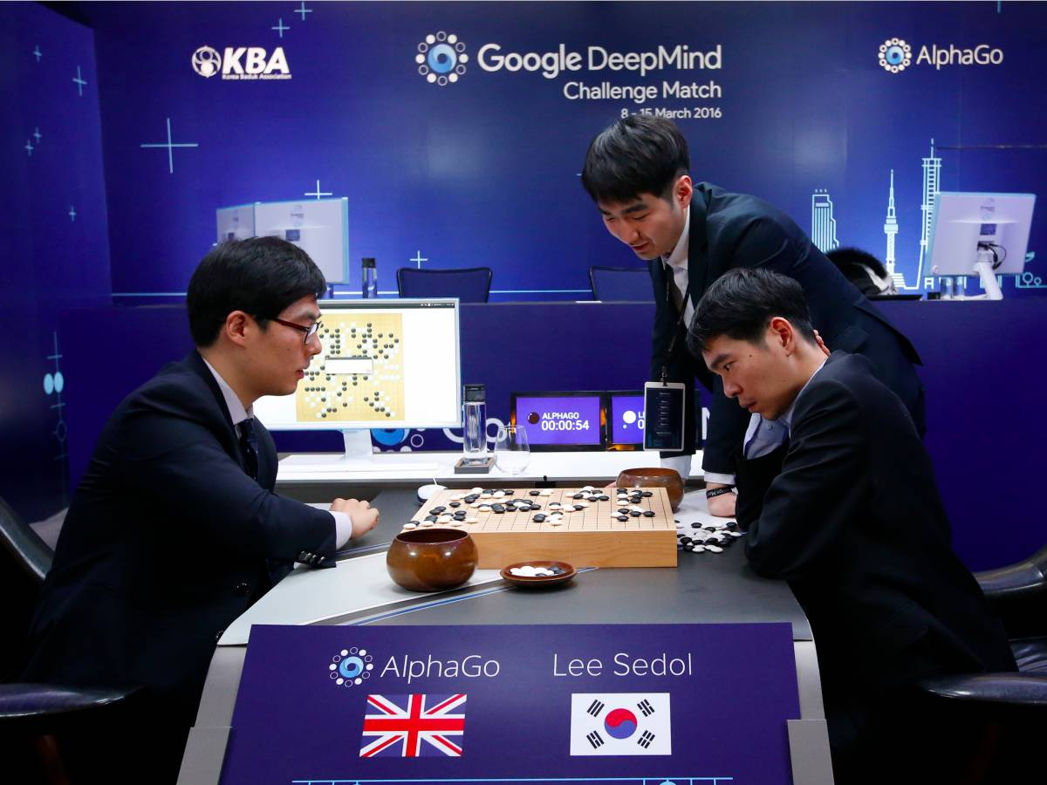
Another grand challenge of AI
Deep Neural Networks were used by Google in Oct 2015 and Mar 2016 to defeat human champions in the game of Go
Notes:
Some called it a “grand challenge” for Artificial Intelligence

Slide 62
A typical argument has been that neural networks have achieved this success by virtue of their brain-like computation and ability to emulate human learning and human cognition.
However, …

Slide 63
Artificial intelligence vs. Human Intelligence
Despite performance achievements, these AI systems differ from human intelligence in many ways e.g.,
What they learn
How they learn

Slide 64
Discussion Intermezzo
WHAT ARE THEY MISSING?

Slide 65
Endowing AI with cognitive science & psychology
Intuitive physics
Theory of mind
Neural Networks +
Discovery of new mental models = Learning-to-learn
Causal reasoning
Inductive biases
More structure
Notes:
Building into the networks.
Leading to more human like learning and development

Slide 66
Endowing neural networks with cognitive science
Argument (Lake et al., in press): As long as natural intelligence remains the best example of intelligence, we believe that the project of reverse-engineering the human solutions to difficult computational problems will continue to inform and advance AI.
! Important Distinction: Of course not all AI is built for the purpose of taking neural inspiration and make claims of cognitive and neural plausibility. (e.g., the Automated Statistician)

Slide 67
Building human-like learning and thinking machines
Lake, Ullman, Tenenbaum & Gershman (2017):
Developmental ingredient: intuitive physics
Developmental ingredient: intuitive psychology
Learning ingredient: model building (causal models)
Learning ingredient: compositionality
Learning ingredient: learning-to-learn
Learning ingredient: speed (our minds are able to build rich models instantly)
Core ingredients of human intelligence
Notes:
Learning ingredients: these are the crucial HUMAN learning aspects that differentiate humans from AI currently, according to these authors.
Causal models: Humans build models about our world constantly in order to make sense of it.
Compositionality: It might seem paradoxical that people are capable of learning these richly structured models from very limited amounts of experience.
Speed: People can comprehend a novel scene in a fraction of a second,
One motivation for NNs in machine vision and speech is to respond as quickly as the brain does.

Slide 68
Why focus on development?
“If an ingredient is present early in development, it is certainly active and available well before a child or adult would attempt to learn the types of tasks discussed here. Thus is true regardless of whether the early-present ingredient itself is learned form experience or innately present.” (Lake et al., in press)
The earlier an ingredient is present, the more likely it is to be foundational to later development and learning.

Slide 69
Building human-like learning and thinking machines
An Important Distinction:
Generic neural networks | Human learning mechanisms
aimed at pattern recognition Not aimed at model building Don’t know how to draw inferences “model-free” | aimed at rich model-building 1. Learn causal model of the task 2. Then use model to plan action sequences Know how to draw inferences “model-based”
Integrate

Slide 70
Building human-like learning and thinking machines
Generic neural networks | Human learning mechanisms
aimed at pattern recognition Not aimed at model building Don’t know how to draw inferences “model-free” | aimed at rich model-building 1. Learn causal model of the task 2. Then use model to plan action sequences Know how to draw inferences “model-based”
Can we teach neural networks to draw inferences?
Notes:
By learning to recognize patterns in these inferences?
This would speed up the inference models (as they are apparently slow – why?)
And the NNs are fast. Why?

Slide 71
Challenges for building more human-like machines
1) The Characters Challenge
Learning simple visual concepts (simple for humans!)

Slide 72
1) The Characters Challenge
Similar to MNIST benchmark for recognizing handwritten digits
→ Just because humans and neural networks perform equally well on the MNIST recognition task, does not mean they learn and think the same way:
People learn from fewer examples
People learn richer representations

Slide 73
1) Learning handwritten characters
1. People can learn to recognize a new handwritten character from a single example
3. People can parse a character into its most important parts and relations.
People learn more than how to do pattern recognition: they learn a concept.
4. People can generate new characters given a small set of related characters.
2. In addition to recognizing new examples, people can also generate new examples.
*Lake et al., 2012
Notes:
Allows them to discriminate the one recognized form examples that are not the character even if they are drawn by someone else.
- These additional abilities come for free along with the acquisition of the underlying concept -

Slide 74
Interim conclusions
People’s additional abilities come for free along with the acquisition of the underlying concept.
People can build models and then use them for arbitrary new tasks and goals.
People learn a lot more from a lot less – and capturing these human-level learning abilities in machines is the challenge.
Notes:
** links to the solution provided in model building (Turing Test)

Slide 75
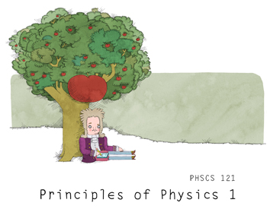
Core Ingredient 1: Intuitive physics
Young children have rich knowledge of intuitive physics
At 2 months and earlier, infants expect inanimate objects to follow principles of persistence, continuity, cohesion and solidity.
At 6 months, infants have developed different expectations for rigid bodies, soft bodies, and liquids.
By their 1st birthday, infants have gone through several transitions of comprehending basic physical concepts such as inertia, containment and collisions
All influences later learning..
Notes:
Liquids go through barriers, while solid objects cannot.
Find more examples!

Slide 76
Core Ingredient 1: Intuitive physics
There is no single agreed-upon computational account of these early physical principles and concepts
Decision trees? (Baillargeon et al., 2009)
Lists of rules? (Sigler & Chen, 1998)
Intuitive physical reasoning as inference over a physics software engine, i.e., the kind of simulators that power modern-day animations and games (Bates et al., 2015, Battaglia et al., 2013; Gerstenberg et al., 2015)

Slide 77
Intuitive physical reasoning as inference over a physics software engine
Hypothesis: People reconstruct a perceptual scene using internal representations of the objects and their physically relevant properties (mass, elasticity, surface friction), and forces acting on the objects (gravity, friction, collision impulses).
intuitive physical state representation is approximate and probabilistic, and oversimplified. → But it can support mental simulations that can predict how objects will move in the immediate future in response to forces or on their own.
Notes:
Approximate compared to the actual ground truth.

Slide 78
Core Ingredient 1: Intuitive physics
http://www.ucl.ac.uk/lagnado-lab/neil_bramley.html
Notes:
Ask Neil what I can say.

Slide 79
Integration 1: Intuitive physics + Neural Networks
1) making predictions without simulating physics: Facebook AI researchers (Lerer et al., 2016) trained a deep convent to predict the stability of block towers (“Jenga”) from simulated images (physical judgment by PhysNet)
2) Alternatively, could a neural network be trained to emulate a general-purpose physics simulator, given the right type and quantity of training data, such as the raw input experienced by a child?
Challenges: what will the deeper layers encode?
How will the deep net generalize?
Notes:
PhysNet outperformed humans on some tasks
2) challenge: in object classification, deeper layers usually become sensitive to higher-level features, from edges to textures etc. , they specialize.
For deep networks trained on physics- related data, it remains to be seen whether higher layers will encode objects, general physical properties, forces and approximately Newtonian dynamics.
Generalize: Learned trajectories of balls bouncing in a box. If this networks has actually learned something like Newtonian mechanics, then it should be able to generalize to interestingly different scenarios, e.g., at least different numers of differently shaped objects, bouncing in boxes of different shapes and sizes and orientations with respect to gravity,
But would it generalize to the Jenga tower?

Slide 80

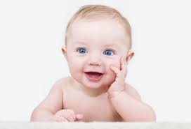
Intuitive psychology
Pre-verbal infants distinguish animate agents from inanimate objects
Infants also expect agents to act contingently and reciprocally, to have goals, and to take efficient actions towards those goals subject to constraints (at 3 months, anti-social agents vs. neutral agents)
One possibility is that intuitive psychology is simple cues “all the way down” (Schlottmann et al., 2013)
Or: generative models of action choice = Formalize concepts such as ‘goal’, ‘agent’, planning’, ‘cost’, used to describe core psychological reasoning in infancy
Applying deep networks here is also new.
→ It could learn visual cues, heuristics and summary stats of a scene with agents.
Notes:
Success of deep net will depend on representations that people use.
Formal account of intuitive psych will need to include representation of agency! Goals, and reciprocal relations!
Im not sure deep learning can learn complex social interactions. Unlikley that the deepnet will learn and understand social agency properly just from training on this.

Slide 81
Core Ingredient 3: Model building
Deep neural networks are extremely data hungry.
Rapid model building: When children learn in their native language, they make meaningful generalizations from only a few examples of a new concepts such as hairbrush or pineapple
Why are NNs so much less efficient? (not always of course)
Even with just a few examples, people can lean remarkably rich conceptual models.

Slide 82
1) Learning handwritten characters
1. People can learn to recognize a new handwritten character even if someone else draws it!
3. People can parse a character into its most important parts and relations.
People learn more than how to do pattern recognition: they learn a concept.
4. People can generate new characters given a small set of related characters.
2. In addition to recognizing new examples, people can also generate new examples.
*Lake et al., 2012
Notes:
Allows them to discriminate the one recognized form examples that are not the character even if they are drawn by someone else.

Slide 83
Core Ingredient 3: Models allow
Concepts support classification
Concepts support prediction
Action
Communication
Imagination
Explanation
Composition
=> These abilities are not independent of the model, rather they hang together and come for free with the acquisition of the underlying concept.

Slide 84
Can we imitate this rapid model building?
Conclusions on the Characters Challenge by Lake et al. (2015)’s probabilistic program induction:
While both people and model represent characters as a sequence of pen strokes and relations, people have a far richer repertoire of structural relations between strokes.
People can efficiently integrate across multiple examples of a character combining different variants into single coherent representation.
-→ AI still not as good as human performance!

Slide 85

Can we imitate this rapid model building?
Lake et al. (2015)’s probabilistic program induction:
People | Machines
Compare the ability to learn new handwritten characters from the world’s alphabets.
Deep learning
Bayesian Program learning (BPL) represents concepts as simple stochastic programs, i.e., structured procedures that generate new examples of a concept when executed

Slide 86
A causal, compositional model of handwritten characters
Notes:
Print out explain figure piece for lecture

Slide 87
Probabilistic inference allows the model to generate new examples from just one example of a new concept
Notes:
Explain the model in words!

Slide 88
Visual Turing Test: Human or Machine?
Notes:
Which gird was generated by the machine? (9 people vs. 9 samples from the BPL model)
Answer is by row for the machine:
1, 2
1, 1

Slide 89
The Competition: Lake, Salakhutdinov, Tenenbaum (2015)
BPL’s learning structure can do one-shot classification at human-level performance & outperform current convolutional deep learning models
Representations that BPL learns also enable it to generalize in other, more creative human-like ways (visual Turing Test)
While both people and model represent characters as a sequence of pen strokes and relations, people have a far richer repertoire of structural relations between strokes.

Slide 90
The 3 main ingredients behind the success of this model:
Compositionality
Causality
Learning-to-learn

Slide 91

The 3 main ingredients behind the success of this model:
Compositionality
= New representations can be constructed through the combination of primitive elements.
** Eric’s lecture will dive into this more.
Notes:
functions

Slide 92
The 3 main ingredients behind the success of this model:
Causality
= Explaining observed data through the construction of causal models of the world
Generative process of BPL model for characters resembles the causal steps of writing in the world
** Dave’s + Christos’ lecture will dive into this more.
Notes:
Allows more rich representation of the world if processes that generated it are part of it
Relating data to its causal source provides strong priors for perception and learning as well as a richer basis for generalizing in new ways to new tasks
- Causal knowledge has also been shown to influence how people learn new concepts

Slide 93
The 3 main ingredients behind the success of this model:
Learning-to-learn
= Theory-based inference
** Active Learning lecture will dive into this more.

Slide 94
The 3 main ingredients behind the success of this model:
Compositionality
Causality
Learning-to-learn
Explaining observed data through the construction of causal models of the world
Hallmark of human-level learning (Lake et al., in press)

Slide 95
Discussion Intermezzo
WHAT IS MISSING?

Slide 96
Conclusions Part II
Richness and flexibility of human learning suggests that learning as model building is better metaphor than learning as pattern recognition
Human capacity for one-shot learning suggests that these models are built upon rich domain knowledge rather than starting from blank slate.
In contrast, much of recent progress in deep learning has been on pattern recognition problems, incl. object recognition, speech recognition, and (model-free) video game learning, which use large data sets but little domain knowledge.
Notes:
Big Data setting

Slide 97
References
Griffiths & Tenenbaum (2006)
Oaksford, M., & Chater, N. (2009). Précis of Bayesian rationality: The probabilistic approach to human reasoning.Behavioral and Brain Sciences, 32(01), 69-84.
Jones, M., & Love, B. C. (2011). Bayesian fundamentalism or enlightenment? On the explanatory status and theoretical contributions of Bayesian models of cognition. Behavioral and Brain Sciences, 34(04), 169-188.
Lake, B. M., Ullman, T. D., Tenenbaum, J. B., & Gershman, S. J. (2016). Building machines that learn and think like people. arXiv preprint arXiv:1604.00289. https://arxiv.org/abs/1604.00289

